Slide 1
Idea/Approach Details Technology Bucket : Miscellaneous Category : Hardware Company Name/ Ministry Name : Shree Cement Ltd Problem Code : MK4 Team Leader Name : Miss. Surbhi Sanjay Wader College Code : 1-3516241198

Slide 2
Industrialization is the period of social and economic change that transform a human group. The small change within the process can alleviate the human effort and the cost of the production. The cement industry face a problem of counting and verification of loaded cements trucks, moreover they do not have a centralized system to gain complete information about the verification.
Sparkhound is the L shaped scanner which scans the top view and the front view of the truck’s goods compartment to determine the sacks of cement load in it. At first, we are going to calculate the maximum length of the truck’s goods compartment considering this length is along horizontal axis(x) similarly we can calculate the height of the truck’s goods compartment considering this along vertical axis(y). The detection of number of stacks of cement loads is done by the vertical section of the L shaped scanner which will be in most cases will only provide further verification. As in this case distance from vertical section will be determined from the outermost column of that particular row. Given the approximate Length, Width & Height of the cement sack is known within some amount of tolerances for each sack; we will get the total number of columns in that particular row. Now the horizontal section of ‘Sparkhound’ will determine the height of the stacks of cement sacks in each column in particular row. Based on these readings from the ‘Sparkhound’ we can compute the total number of sacs in each column of particular row and similarly we can proceed for all remaining rows in the truck’s goods compartment. After all the calculation we will get the final count of the sacs and verification can be done.
Idea Description :

Slide 3
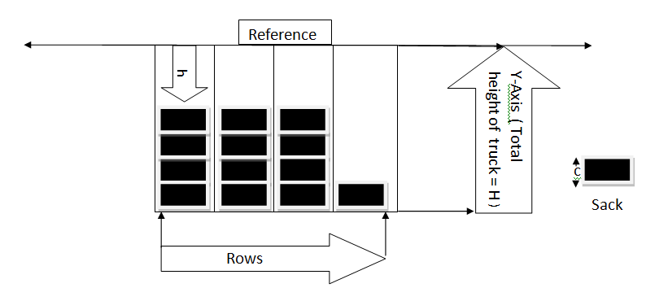
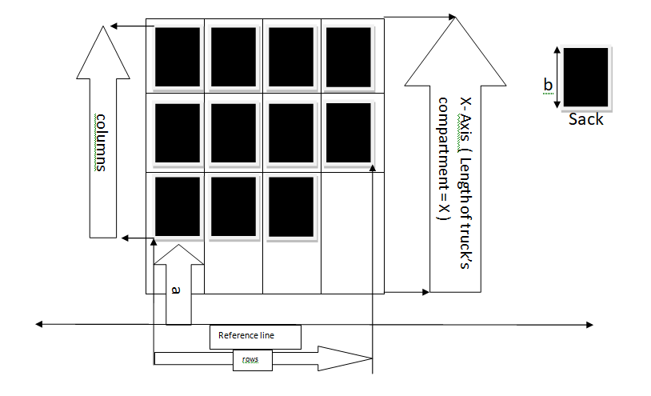
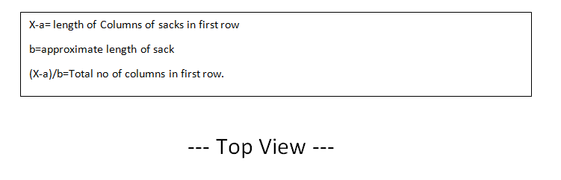
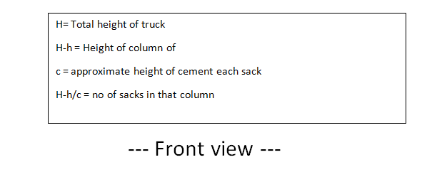
Block Diagram :

Slide 4
Technology stack :
Data Base
Web page(Thingspeak)
Browser(Chrome, Microsoft edge)
Hardware components:
LCD, Keypad, ultrasonic range finder
Connectivity module (WiFi - ESP8266 )
Controller (Arduino/Raspberry-pi)

Slide 5
1. For proper working of ‘Sparkhound’ the sacs should be arranged in particular manner so format of sacks’ arrangement while loading trucks should be specified.
Use case Diagram :
Enter the info of truck number and initial sack count through
keyboard
in Sparkhound
Central system
operator
database
Acknowledgment of the Data and count received
Scanning of cement sacks using Sparkhound
Verification of initial count manually done and the results from Sparkhound
Dependencies/Show stopper :

